Slide 1
Independent Study in Robotics:
ORB_SLAM2 integration with Robobulls Robot
Justin Rodney

Slide 2
Preface
After initially configuring ORB_SLAM2, how can we use the pose and PointCloud it publishes?
Ideal applications
Autonomous Exploration in an unknown environment to create maps
Autonomous Navigation in a known environment via path planning
ROS packages provide these features, but are incompatible with the current system because the lack of odometry information(Navigation, Exploration_lite).
Current application with our robot: bug algorithm using published Pose information

Slide 3
Required Packages
ROS Kinetic
Existing ROS package on Robot and Client.
Rviz*
Telop*
ORB_SLAM2(ROS implementation)
*included in full installation of ROS Kinetic

Slide 4
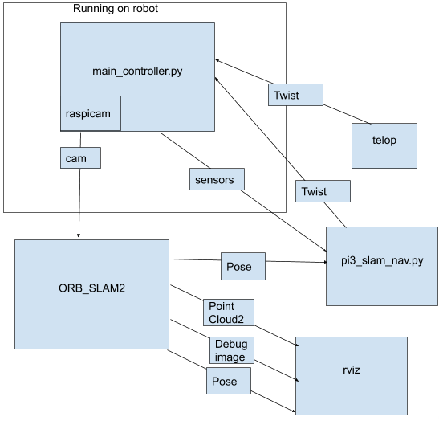
Software system

Slide 5
ORB_SLAM2
Is a simultaneous localization and mapping package that takes monocular, stereo, and RGBD camera’s as input. Monocular is NOT true scale.
Publishes
PointCloud2
All the identified keypoints in the map
debug_image
Shows the image from the robots camera
Identified keypoints marked on the overlay
Shows whether the robot is currently localized
Pose
Has the robots x,y, and z coordinates as well as quaternion

Slide 6
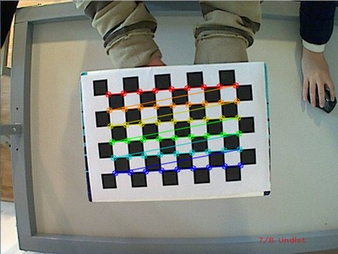
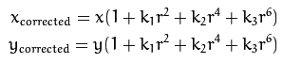
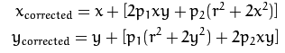
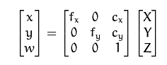
Setting up ORB_SLAM2
Use a checkerboard pattern with OpenCV’s calibration program. Use output to set parameters in ORB_SLAM2’s launch files
Corrects distortion
https://docs.opencv.org/2.4/doc/tutorials/calib3d/camera_calibration/camera_calibration.html

Slide 7
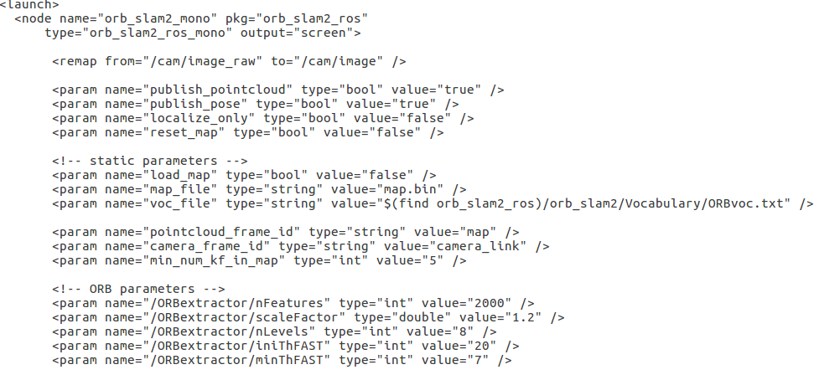
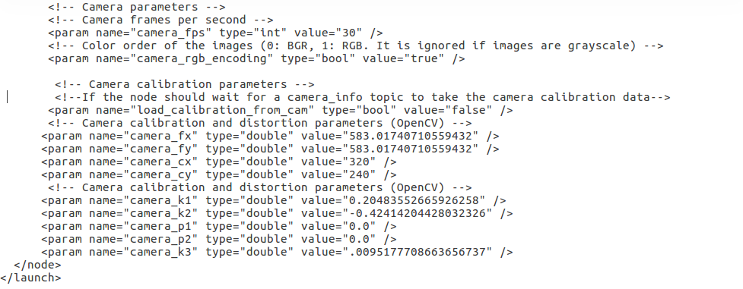
Launch File
Important parameters:
Remap from=
localize only
load map/map_file
Camera calibration parameters

Slide 8
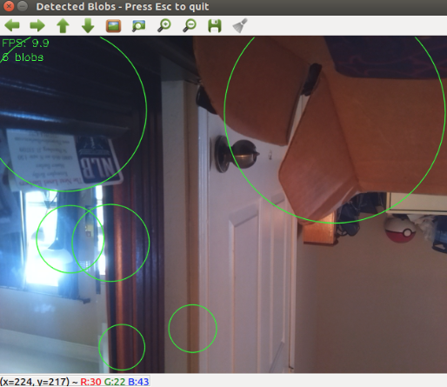
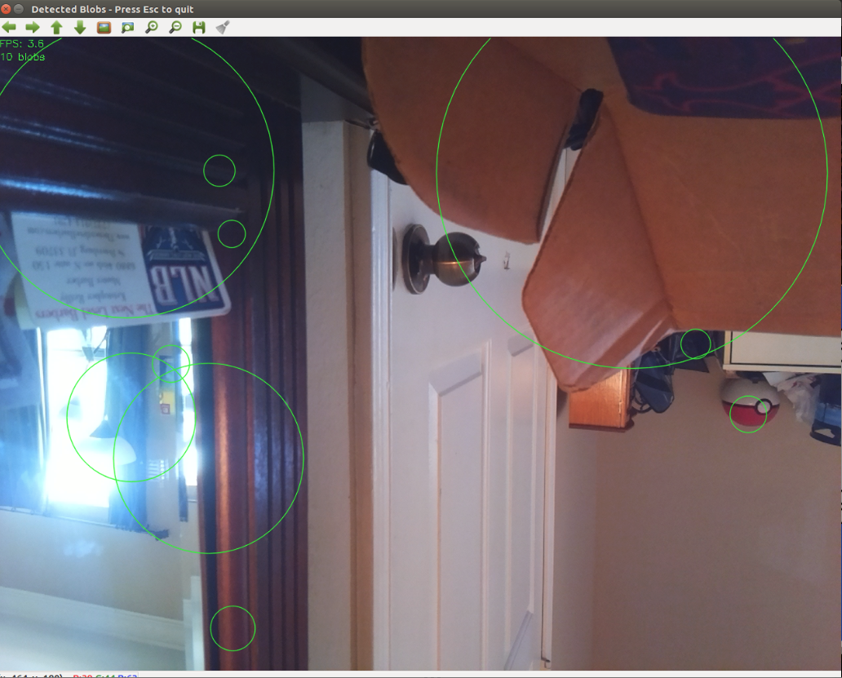
FPS performance
*from blob detection program, not ORB_SLAM2.
ORB_SLAM2 is more demanding
Tested performance:
On 3 wifi networks
With ROScore running on robot and client computer
Lower FPS reduces localization
640x480
1280x960

Slide 9
Running The Program
Start Rviz
Start ORB_SLAM2
Start telop to control robot to create map
Start pi3_slam_nav.py

Slide 10
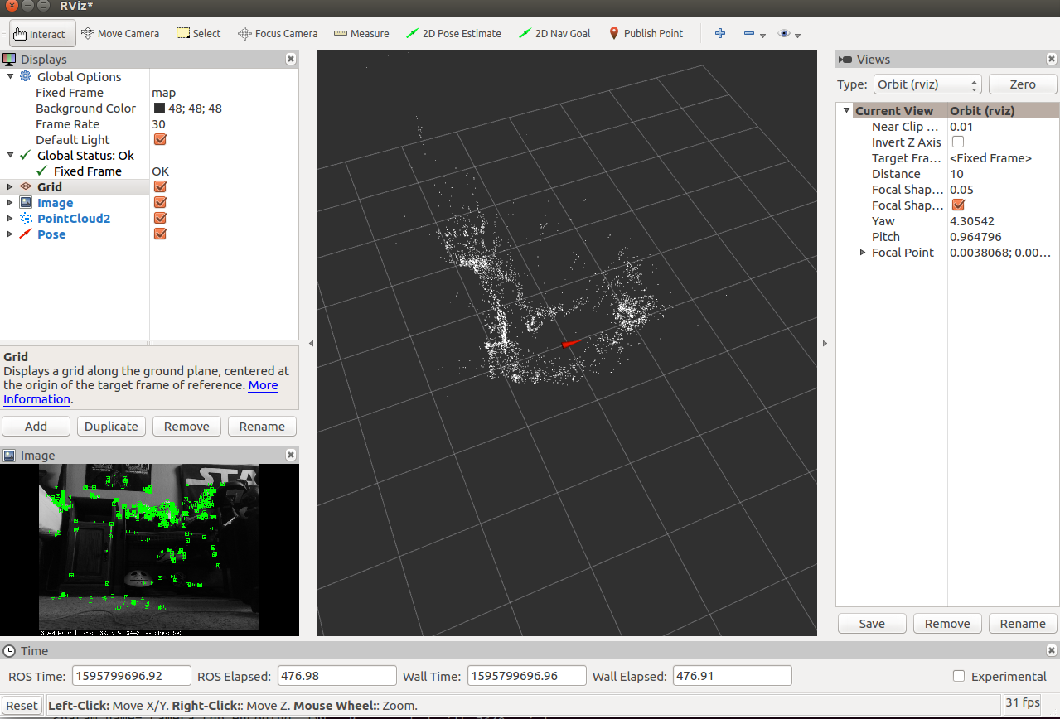
Rviz

Slide 11
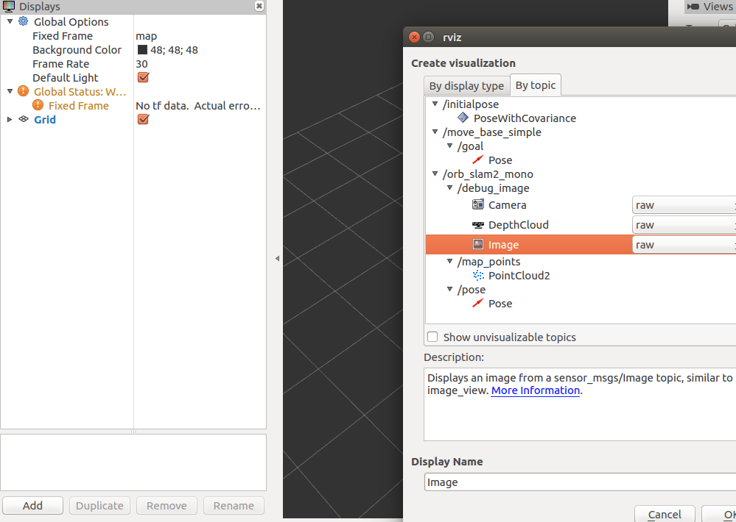
Setting Rviz Parameter #1
Debug_image
Map_points
pose

Slide 12
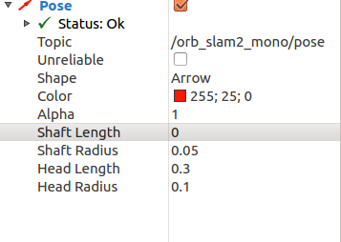
Setting Rviz Parameter #2
Set Shaft Length= 0

Slide 13
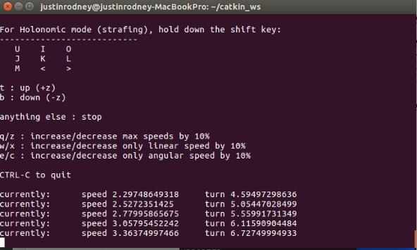
Telop
rosrun teleop_twist_keyboard teleop_twist_keyboard.py cmd_vel:=/pi3_robot_2019/r1/speed_vw

Slide 14
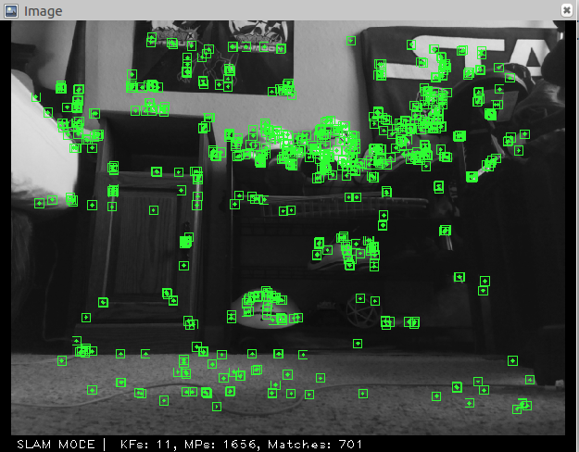
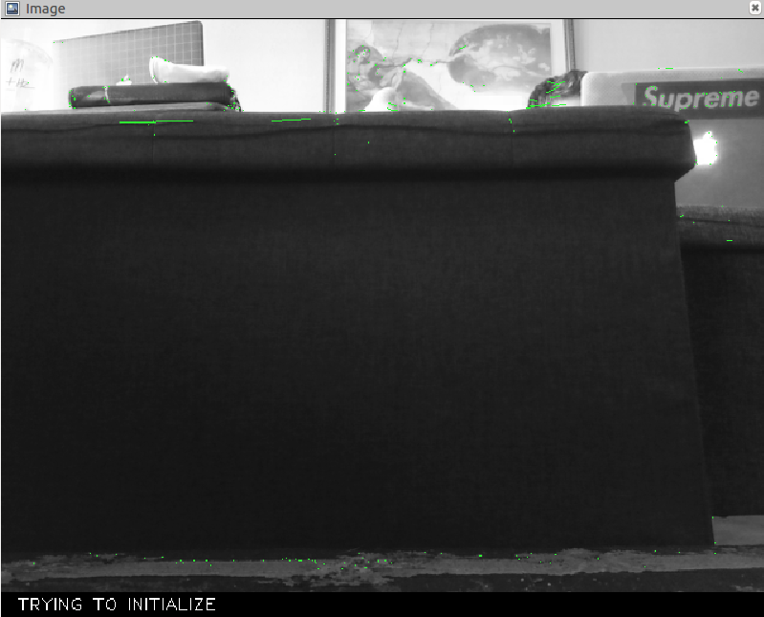
Point Generation
Does not work on objects that are too dark or too light
Also found in Yu-Ting Chung’s study on using raspberry pi with ORB_SLAM2

Slide 15
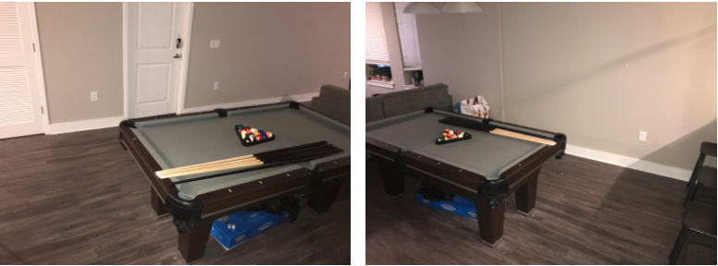
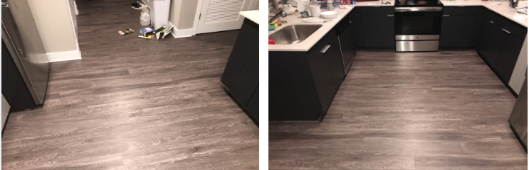
Environment 1 & 2
Kitchen
Living area 1

Slide 16
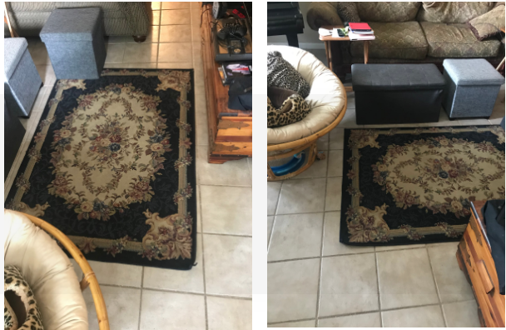
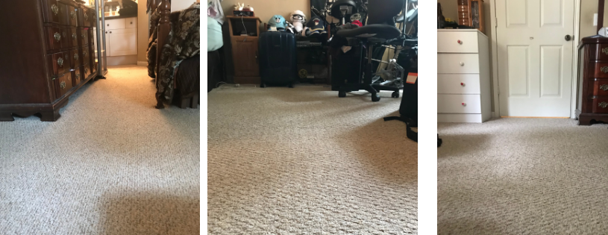
Environment 3 & 4
Bedroom
Living area 2

Slide 17
Mapping Methods tested
Wall following
Spinning the robot in a circle in the middle of the room
Manual Mapping

Slide 18
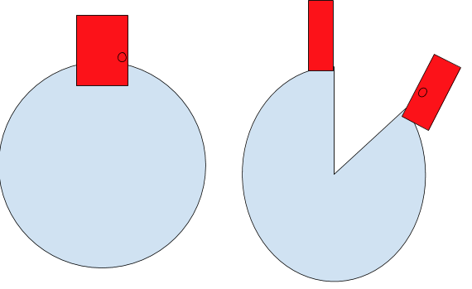
Skewed map
If the robot was inside of a circle with a red door, instead of capturing the full 360 degrees of the environment, the map would have a portion of the map left blank with the rest of the environment skewed.

Slide 19
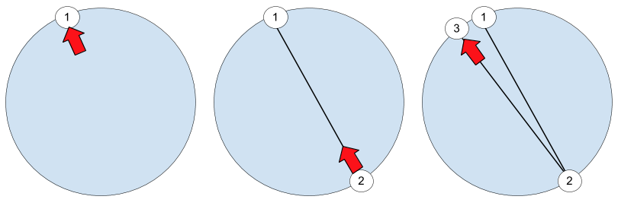
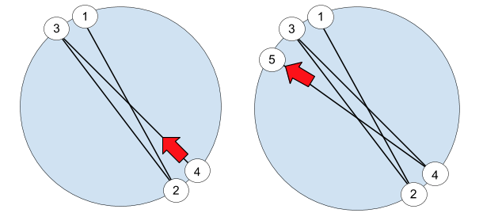
Mapping Motion

Slide 20
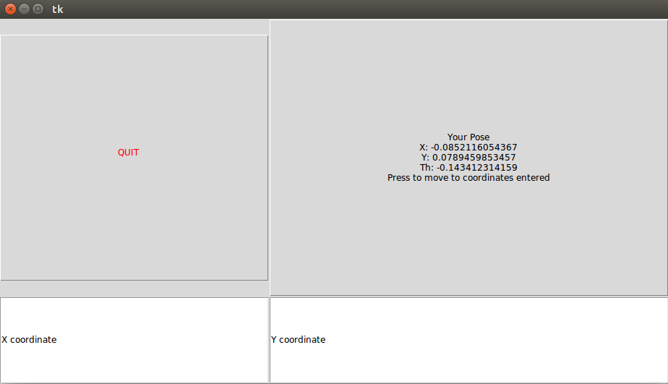
pi3_slam_nav
Uses the x, y, and yaw and the x and y coordinates of the goal to calculate the required yaw for the robot to be facing the goal.
Uses wall following for obstacle avoidance
Desired angle = atan2(goalY- currentY, goalX-currentX)
Distance = (goalX-currentX)^2 + (goalY-currentY)^2

Slide 21
The downfalls
<10 FPS even when using the lowest usable resolution(640x480)
Depth is approximated when the map is initialized. Cannot be converted to units of measurements.
RGB processing cannot be used without RGBD capable cameras(stereo).
Incompatible with Navigation(used with many ROS packages including autonomous navigation viapath planning) and Exploration_lite(autonomous exploration).
ORB_SLAM2 does not project proper transforms necessary for these packages

Slide 22
Why use ORB_SLAM2?
ORB_SLAM2 is the only ROS package that is capable of SLAM using a mono-camera alone.
Other packages require IMUs, laser scanners, and stereo or RBGD cameras.

Slide 23
Octomap
Creates an occupancy grid from PointCloud2 topic from ORB_SLAM2
Unfortunately, unreliable in conjunction with ORB_SLAM2.
Further refinement of parameters could create reliable maps for path_planning

Slide 24
Benefits of Upgrading the Robot
Rtabmapping
Gives proper transform(tf) tree from map to odometry
Requires a laser scanner, but produces true to scale maps
Creates an occupancy grid
Can recognize specific objects in an environment
Allows the use of navigation and exploration_lite
odom
cam
Navigation
Rtabmapping
tf
Sensor info
Laser
Scanner
map

Slide 25
Conclusion
Current system:
Provides pose information inside a depth approximated grid
Can be used for bug algorithms and other simple applications
Having better sensors would allow us to:
Create true to scale maps
Laser scanners/stereo cameras perform better
Wider compatibility with other ROS packages

Slide 26
Works Referenced
Camera Calibration. (n.d.). Retrieved July 26, 2020, from https://docs.opencv.org/2.4/doc/tutorials/calib3d/camera_calibration/camera_calibration.html
Chung, Y. (2018, July 18). Final Report. Retrieved July 30, 2020, from https://github.com/biorobaw/SLAM-S2018/blob/master/docs/Reports/final%20report.pdf
Gmapping. (n.d.). Retrieved July 26, 2020, from http://wiki.ros.org/geometry_msgs
Gmapping. (n.d.). Retrieved July 26, 2020, from http://wiki.ros.org/gmapping
Navigation. (n.d.). Retrieved July 26, 2020, from http://wiki.ros.org/navigation
Octomap. (n.d.). Retrieved July 26, 2020, from http://wiki.ros.org/octomap
Orb_slam2_ros. (n.d.). Retrieved July 26, 2020, from http://wiki.ros.org/orb_slam2_ros
Rtabmap_ros. (n.d.). Retrieved July 26, 2020, from http://wiki.ros.org/rtabmap_ros

